Slide 1

Predicting Default of Credit Card Clients
Abiola Ijaola
DATA606 Capstone
UMBC
Delivarable2

Slide 2
Presentation Approach
Project overview
Check for data unbalance
Exploratory data analysis
Model construction
Conclusions

Slide 3
Recap of the project
Dataset
The dataset is collected from Department of Information Management, Chung Hua University, Taiwan and Department of Civil Engineering, Tamkang University, Taiwan.
The source URLs for the data is
https://archive.ics.uci.edu/ml/datasets/default+of+credit+card+clients.
I will be using open source software and code (Python & Jupiter Notebook)

Slide 4
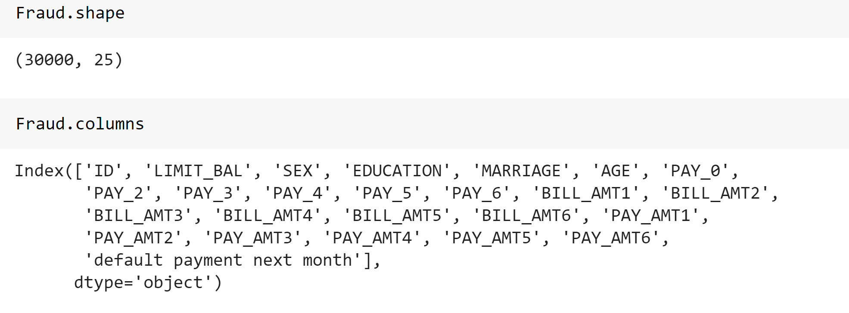
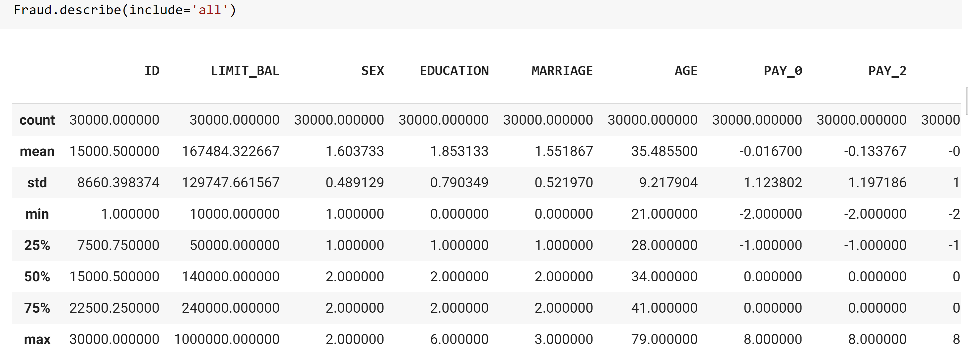
Preliminary Exploratory Data Analysis
First Look

Slide 5
Exploratory Data Analysis
The purpose of exploratory data analysis is to perform pattern discovery analysis on data using summary statistics and graphical representations

Slide 6
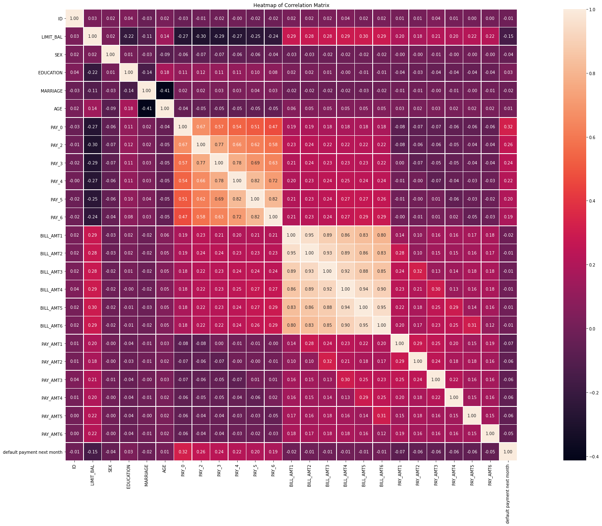
Correlations among variables
Based on the correlation matrix, there is a strong positive correlation between any two monthly payment status: in all such cases, the correlation coefficients were between 0.47 to 0.82. For instance, the payment status in September tends to increase as that of May (correlation coefficient, R = 0.51), similarly the payment status in April correlated positively with that of August (R = 0.58).

Slide 7
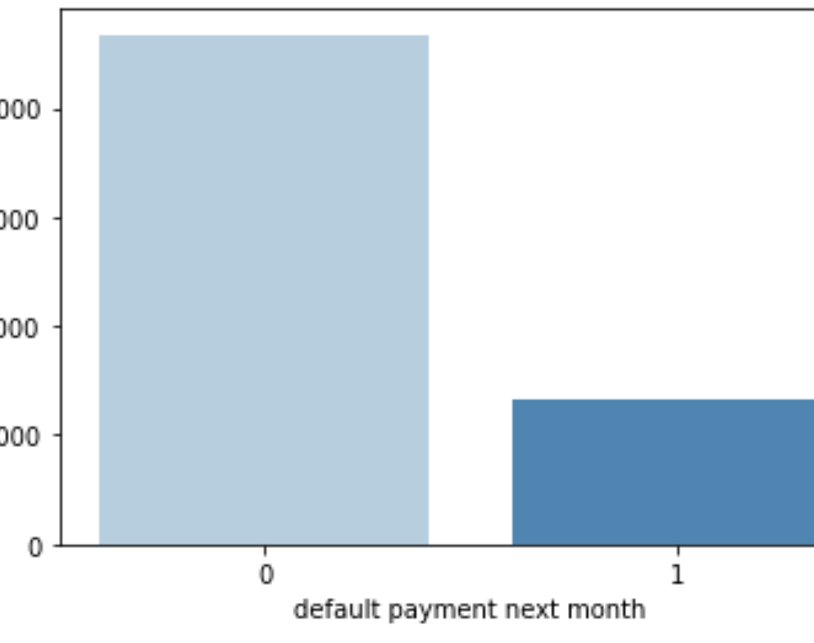
Frequency Plot for Default Payment
About 22% of the credit card clients default in their next monthly payment, while the remaining 78 % tend to meet their monthly credit card payment obligation.
0 - 23364
1 - 6636

Slide 8
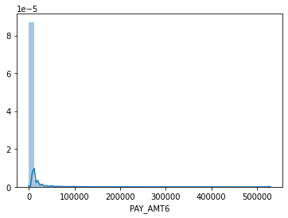
Distribution Plot for PAY_AMT6
The distribution plot for the amount of previous payment is April 2005 showed the most of the payment amount ranges between $0 to $ 30,000. Other higher amounts are present but at a much lesser count.

Slide 9
Exploratory Data Analysis Outcome
All the data types are all int64.
There is no missing data in the entire dataset.
From my analysis, the result shows that we are dealing with imbalance
classes.
I discovered some outliers in the features so I have to remove 1% of the
features which will be used to build the algorithms.

Slide 10
Model Construction Methodology
Split dataset into training and test sets.
Run Logistic Regression, Random Forest, Decision Tree,
KNeighbors and Gaussians algorithms.
Test model.
Check accuracy.

Slide 11
Next Steps
Run Algorithms
Interpretation

Slide 12
Thank you

